Slide 1
Grid, Virtualization and Cloud Computing
Distributed Computer Systems
CT024-3-3-DCOMS and Version VC1

Slide 2
Topic & Structure of The Lesson
Introduction to Grid Computing
Virtualization
Hypervisor
Cloud Computing

Slide 3
Learning Outcomes
At the end of this topic, You should be able to
Understand the technology of Grid
How Grid is different from Cloud
Explain the concept of Virtualization

Slide 4
Key Terms You Must Be Able To Use
If you have mastered this topic, you should be able to use the following terms correctly in your assignments and exams:
Grid
Cloud
Hypervisor
Virtualization

Slide 5
Introduction to Grid Computing
The term Grid comes from an analogy to the Electric Grid.
Pervasive access to power.
Similarly, Grid will provide pervasive, consistent, and inexpensive access to advanced computational resources.
Grid computing is all about achieving greater performance and throughput by pooling resources on a local, national, or international level.

Slide 6
Grid Computing
Grids are about large-scale resource sharing.
Spanning administrative boundaries.
Central processors, storage, network bandwidth, databases, applications, sensors and so on
Problem solving in dynamic, multi-institutional environment.
Organizing geographically distributed computing resources
So that they can be flexibly and dynamically allocated and accessed
Providing such capabilities, where Sharing is highly controlled, clear definitions of exactly what is shared, who is allowed to share, and the conditions under which sharing occurs.

Slide 7
Elements of Grid Computing
Resource sharing
Computers, data, storage, sensors, networks, …
Sharing always conditional: issues of trust, policy, negotiation, payment, …
Coordinated problem solving
Beyond client-server: distributed data analysis, computation, collaboration, …
Dynamic, multi-institutional virtual organizations
Community overlays on classic org structures
Large or small, static or dynamic

Slide 8
Definition
Virtualization is the ability to run multiple operating systems on a single physical system and share the underlying hardware resources*
It is the process by which one computer hosts the appearance of many computers.
Virtualization is used to improve IT throughput and costs by using physical resources as a pool from which virtual resources can be allocated.
*VMWare white paper, Virtualization Overview

Slide 9
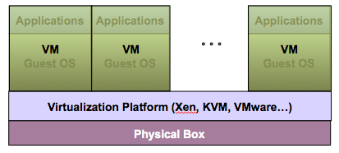
Virtualization Architecture
A Virtual machine (VM) is an isolated runtime environment (guest OS and applications)
Multiple virtual systems (VMs) can run on a single physical system

Slide 10
Hypervisor
A hypervisor, a.k.a. a virtual machine manager/monitor (VMM), or virtualization manager, is a program that allows multiple operating systems to share a single hardware host.
Each guest operating system appears to have the host's processor, memory, and other resources all to itself. However, the hypervisor is actually controlling the host processor and resources, allocating what is needed to each operating system in turn and making sure that the guest operating systems (called virtual machines) cannot disrupt each other.

Slide 11
Benefits of Virtualization
Sharing of resources helps cost reduction
Isolation: Virtual machines are isolated from each other as if they are physically separated
Encapsulation: Virtual machines encapsulate a complete computing environment
Hardware Independence: Virtual machines run independently of underlying hardware
Portability: Virtual machines can be migrated between different hosts.

Slide 12
Virtualization in Cloud Computing
Cloud computing takes virtualization one step further:
You don’t need to own the hardware
Resources are rented as needed from a cloud
Various providers allow creating virtual servers:
Choose the OS and software each instance will have
The chosen OS will run on a large server farm
Can instantiate more virtual servers or shut down existing ones within minutes
You get billed only for what you used

Slide 13
Virtualization Security Challenges
The trusted computing base (TCB) of a virtual machine is too large.
TCB: A small amount of software and hardware that security depends on and that we distinguish from a much larger amount that can misbehave without affecting security*
Smaller TCB → more security
*Lampson et al., “Authentication in distributed systems: Theory and practice,” ACM TCS 1992

Slide 14
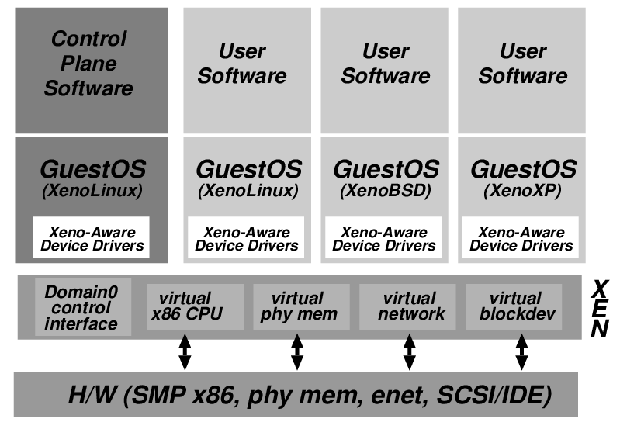
Xen Virtualization Architecture and the Threat Model
Management VM – Dom0
Guest VM – Dom
Dom0 may be malicious
Vulnerabilities
Device drivers
Careless/malicious administration
Dom0 is in the TCB of DomU because it can access the memory of DomU, which may cause information leakage/modification

Slide 15
Virtualization Security Requirements
Scenario: A client uses the service of a cloud computing company to build a remote VM
A secure network interface
A secure secondary storage
A secure run-time environment
Build, save, restore, destroy

Slide 16
Virtualization Security Requirements
A secure run-time environment is the most fundamental
The first two problems already have solutions:
Network interface: Transport layer security (TLS)
Secondary storage: Network file system (NFS)
The security mechanism in the first two rely on a secure run-time environment
All the cryptographic algorithms and security protocols reside in the run-time environment

Slide 17
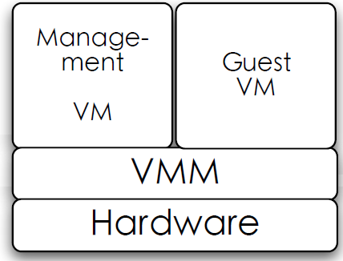
Smaller TCB Solution
Smaller TCB
Actual TCB
*Secure Virtual Machine Execution under an Untrusted Management OS. C. Li, A. Raghunathan, N.K. Jha. IEEE CLOUD, 2010.

Slide 18
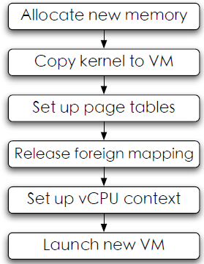
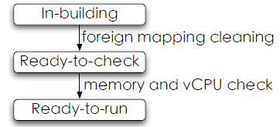
Domain building
Building process

Slide 19
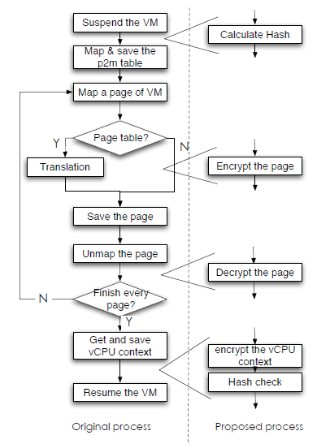
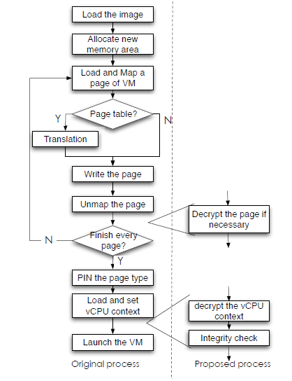
Domain save/restore

Slide 20

Hypervisor Vulnerabilities
Malicious software can run on the same server:
Attack hypervisor
Access/Obstruct other VMs
Guest VM1
Guest VM2
Apps
Apps
OS
OS
Hypervisor
servers
Physical Hardware

Slide 21
Roles of the Hypervisor
Isolating/Emulating resources
CPU: Scheduling virtual machines
Memory: Managing memory
I/O: Emulating I/O devices
Networking
Managing virtual machines
Push to HW /
Pre-allocation
Remove
Push to side

Slide 22
Removing the Hypervisor
Scheduling virtual machines
One VM per core
Managing memory
Pre-allocate memory with processor support
Emulating I/O devices
Direct access to virtualized devices
Networking
Utilize hardware Ethernet switches
Managing virtual machines
Decouple the management from operation

Slide 23
Summary
Cloud Computing enables us to easily use software as well as processing platforms and computing infrastructure (that are not equipped on our computers and smartphones) from any location through Internet services
Big Data provides us with new intelligence from massive data sets, which can help in situation/condition/status analysis and decision making.
In addition, CDN is the best technology to provide information/contents to Internet users in the quickest and most efficient way. Therefore, the information/software/database/contents from Clouds and Big Data centers can be very effectively supported by CDNs.

Slide 24
Question and answer session
Q & A

Slide 25
What we will cover next
Revision

